Slide 1
State of the Division
November 9, 2017

Slide 2
Purpose
Highlight areas of celebration from the 2016-2017 school year
Discuss areas for continued focus in 2017-2018 and beyond
Hear feedback from the board on the report

Slide 3
Accolades
India Haun
Chris Gilman
Garry Barrow
Lorenzo Dickerson

Slide 4
State of the Division
Moved to an online format two years ago
Updated site shared with board members on October 24

Slide 5
Mission and Vision
Our Mission
The core purpose of Albemarle County Public Schools is to establish a community of learners and learning, through relationships, relevance, and rigor, one student at a time.
Our Vision
All learners believe in their power to embrace learning, to excel, and to own their future.

Slide 6
Our Core Values
Excellence
We believe in meaningful learning that stretches people to the frontiers and boundaries of their abilities.
Young People
We believe young people deserve the best we have to offer. Each individual child is capable and has the right to safety, mutual respect, and learning.
Community
We believe in our collective responsibility to work together in a cooperative effort to achieve common goals by building communities of practice, establishing a high quality learning community, and listening to the community.
Respect
We believe in treating all individuals with honor and dignity.

Slide 7
One Student-Centered Goal
All students will graduate prepared for citizenship, post-secondary education and workforce entry levels as evidenced by multiple indicators of lifelong learning competencies.

Slide 8
Strategic Objectives
Engage Every Student
Implement Balanced Assessments
Improve Opportunity and Achievement
Create & Expand Partnerships
Optimize Resources

Slide 9
Strategic Priorities 2015-2017
All students will graduate prepared for citizenship, post-secondary education, and workforce entry levels as evidenced by multiple indicators of lifelong learning competencies.
Increase the number of students accruing college credits and career pathway credentials prior to graduation.
Increase the efficacy of our instructional staff by developing the pedagogical expertise essential to contemporary learning.
Achieve a fully-funded capital and operational budget that meets the school system’s needs for learning space modernization, instructional innovation, digitized learning, and competitive recruitment and retention of personnel. Optimize the use of all allocated fiscal resources to meet the goals of the division.

Slide 10
Strategic Priorities 2017-2019
Create a culture of high expectations for all
Identify and remove practices that perpetuate the opportunity gap
Ensure that students identify, develop and have opportunities to pursue personal interests

Slide 11
Areas For Celebration

Slide 12
Accreditation Status
24 out of 25 school fully accredited
Several schools moved from “accredited with warning” to “fully accredited”
  Greer—Data analysis teams and protocols for support
  Walton—PLCs working with data coach
  Jouett—Pre- and Post-assessments with feedback
  Stone Robinson—Unpacking Standards in PLCs

Slide 13
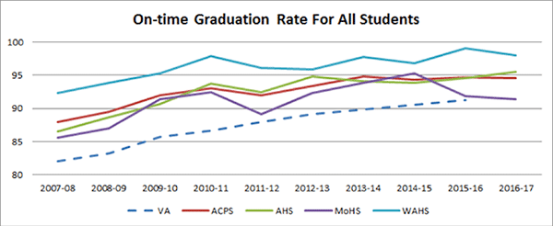
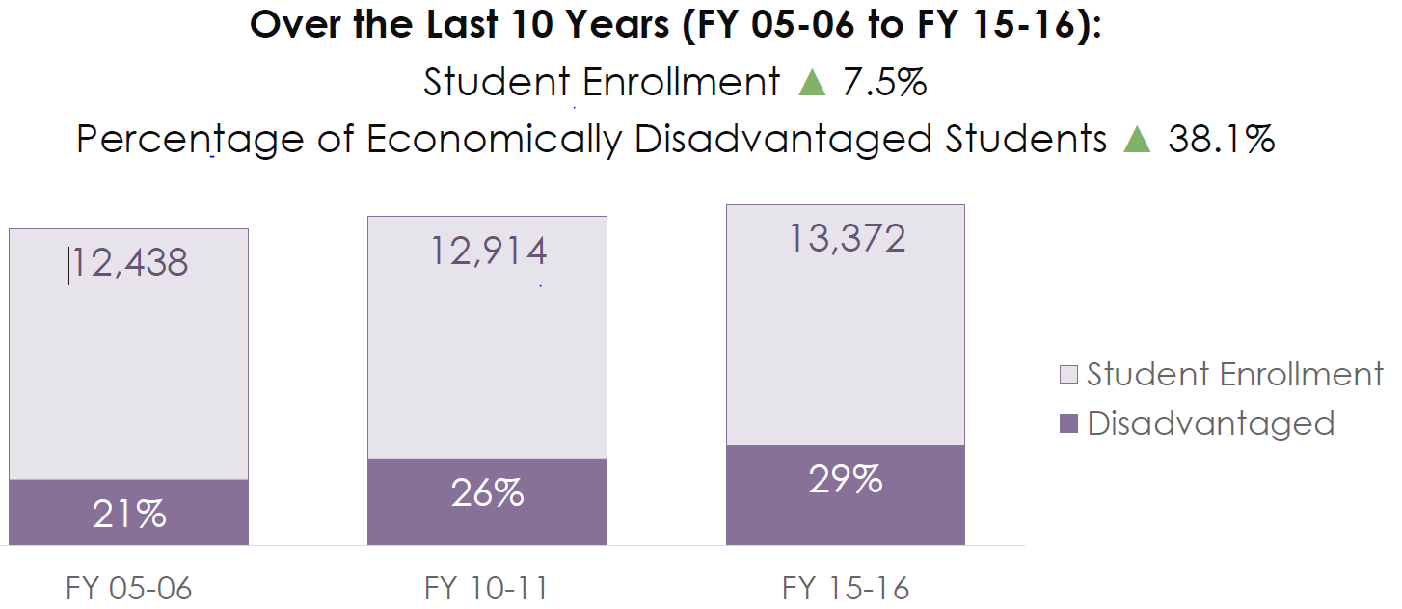
On-time graduation rates
Consistently exceed the state graduation rate.
Division 95% rate is something to continually celebrate.
All schools are above the 90% rate.
7% increase over the past 10 years
Maintaining despite shifting demographics

Slide 14
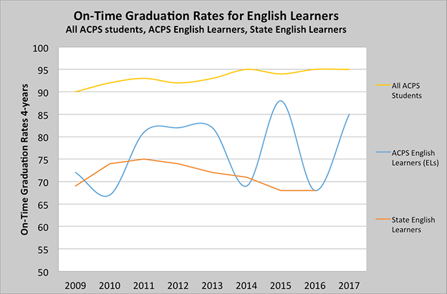
ESOL Graduation Rates
ESOL graduation rates are higher than their state peers for the past seven years.
Possible because ACPS provides staffing for this program that is above the state standards.
Notes:
GEt explanation from Cyndi

Slide 15
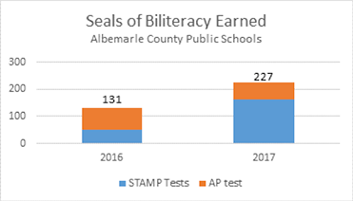
Seals of Biliteracy
Awarded to students who show high levels of language proficiency, particularly in writing and speaking
Push toward “comprehensible input” by students in class
3+ on AP exam, Intermediate-Mid or higher national assessment
Increased from 131 students in 2016 to 227 in 2017
STAMP pass rates increased from 8% to 23%

Slide 16
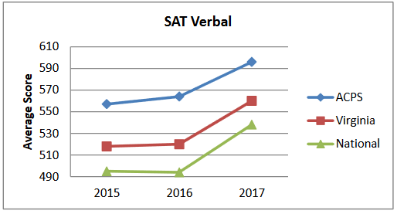
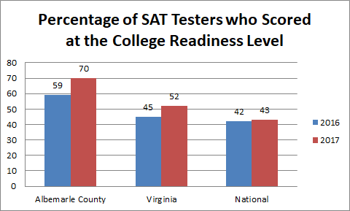
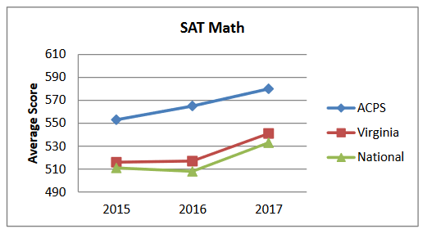
SAT Scores
Scores have gone up
This is a new starting point with a new version of the test
Three years for new trends
Academic indicators--College readiness indicator may be a better metric to begin using.

Slide 17
State and National accolades
Niche Ratings—Moved from fifth to third on the overall ratings for the state
Pam Moran—Finalist for Superintendent of the Year
Debora Collins—Curriculum Leader of the Year—VASCD
DeeDee Jones—Impact Award—VASCD
Chad Ratliff—National School Board Association “Twenty to Watch” Education Leaders
XQ—Top 50 finalist for the XQ Super School grant

Slide 18
Areas for Continued Focus
Inequity
Under-representation in gifted ID, SOL pass rates, higher level math courses, advanced studies diplomas
Over-representation in special eduation identification, chronic absenteeism and out-of-school suspensions

Slide 19
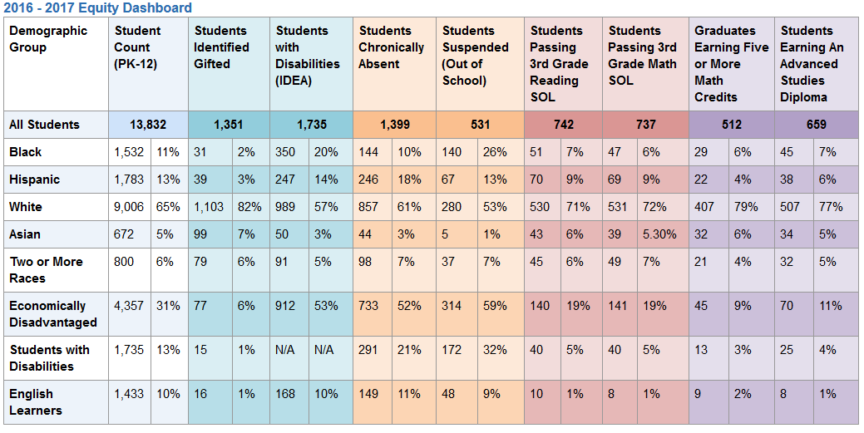
Equity Dashboard—Baseline

Slide 20
Questions
What pleases you?
What surprises you?
What concerns you?
What is the report missing?

